Slide 1
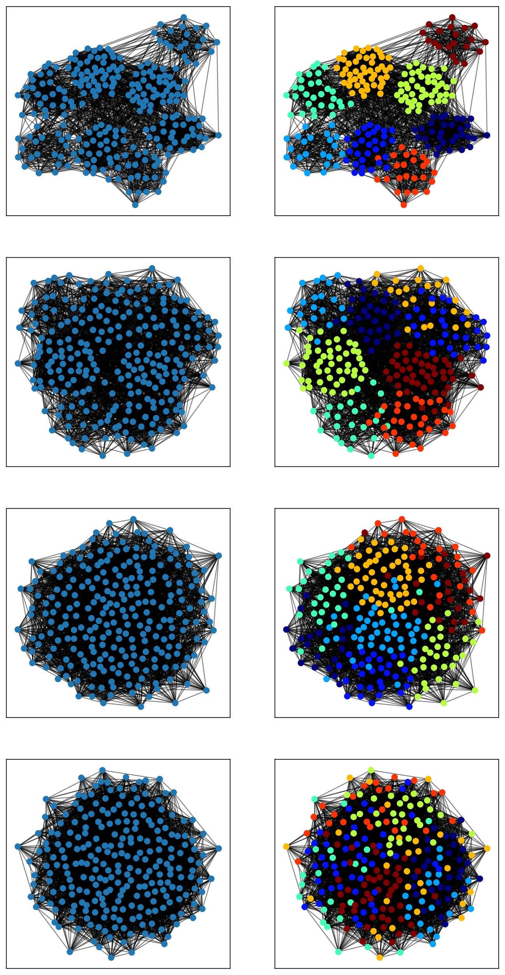
Experimental Setup
Mixing parameter µ increases
LFR Benchmark
Graph Sizes: 250, 500
Node degree power exponent: 2.0
Community power exponent: 1.1
Minimum Degree: 20
Maximum Degree: 50
NMI Score
Increase µ overtime: 0.1 – 0.7
Partitioning Algorithm: Louvain Core
Notes:
The general experimental setting is quite simple. I am using the LFR Benchmark. The slide lists some of the parameters. I vaired the mixing parameter until 0.7 because the theoretical limit of detectability was 0.75.
I am going to fix the partitioning algorithm or heuristic but inspect the results of different models, which I have implemented myself. So the models are a bit more interesting.

